Slide 1
Database Applications and Information Systems
Topic: Relational Model
Dr. Dan Lin

Slide 2
Brief Review
Entity-Relationship (ER) Model
  Entity
  Relationship
  Weak entity
EER Model
  Subclass/superclass

Slide 3
Chapter Outline
Relational Model Concepts
Relational Model Constraints
Update Operations &
Dealing with Constraint Violations

Slide 4
A Relation is a Table
Attributes
(column
headers)
name manf
Winterbrew Pete’s
Bud Lite Anheuser-Busch
Beer
Cardinality = # of rows
Arity/Degree = # of columns
Tuples
(rows)

Slide 5
Key
Key of a Relation:
  Each row has a value of a data item (or set of items) that uniquely identifies that row in the table, called the key
  In the Beer table, name is the key
  Sometimes row-ids or sequential numbers are assigned as keys to identify the rows in a table, called artificial key or surrogate key

Slide 6
Why Relations?
Very simple model.
Often matches how we think about data.
Abstract model that underlies SQL, the most important database language today.
  But SQL uses bags, while the relational model is a set-based model.

Slide 7

Relational Model History
The model was first proposed by Dr. E.F. Codd of IBM Research in 1970 in the following paper:
  "A Relational Model for Large Shared Data Banks," Communications of the ACM, June 1970
The above paper caused a major revolution in the field of database management and earned Dr. Codd the coveted ACM Turing Award.

Slide 8
Schemas
Relation schema = relation name + attributes, in order (+ types of attributes).
  Example: Beers(name, manf) or Beers(name: string, manf: string)
Database = collection of relations.
Database schema = set of all relation schemas in the database.

Slide 9
Formal Definitions - Schema
The Schema (or description) of a Relation:
  Denoted by R(A1:type₁, A2:type₂, ..., An:type_{n})
  R is the name of the relation
  The attributes of the relation are A1, A2, ..., An
  The data types of the attributes are type₁ , type₂ , ..., type_{n}
  The data type is represented by a domain of possible values.

Slide 10
Formal Definitions - Tuple
A tuple is an ordered set of values (enclosed in angled brackets ‘< … >’)
  ti=<v1,v2,…, vn>
  For example, 1st tuple in the Beer relation can be represented as t1= <Winterbrew, Pete’s >
  t1[Ai] or t1.Ai refers to the value vi in t1 for attribute Ai.
  For example, t1[name]=<‘Winterbrew’>.
  Similarly, t[Ai, Aj, ..., Aw] refers to the subtuple of t containing the values of attributes Ai, Aj, ..., Aw, respectively in t

Slide 11
Formal Definitions - State
r(R) represents a specific state (or “population”) of relation R(A1,A2,…,An)
  r(R) is a set of tuples (rows) in R
  r(R) = {t1, t2, …, tm}, where each ti is a tuple in R
  ti = <v1, v2, …, vn>, where each vj is a value of attribute Aj
R is also called the intension of a relation
r is also called the extension of a relation

Slide 12
Definition Summary
Informal Terms Formal Terms
Table Relation
Column Attribute/Domain
Row Tuple
Alll possible Values in a column Domain
Table Definition Schema of Relation
Populated Table Extension/State

Slide 13
Characteristics Of Relations
Ordering of tuples in a relation r(R)
  The tuples are not considered to be ordered, even though they appear to be in the tabular form.
  Tuples can have different logical orderings.
Ordering of attributes in a relation schema R (and of values within each tuple)
  We will consider the attributes in R(A1, A2, ..., An) and the values in t=<v1, v2, ..., vn> to be ordered
  Though, at a logical level, such order is not very important

Slide 14
Example of Identical Relations
Bar Drinker Beer
Joe’s Bar Ann Miller
Sue’s Bar Ann Bud
Joe’s Bar Bob Miller
Sue’s Bar Cal Bud Lite
Bar Drinker Beer
Sue’s Bar Ann Bud
Joe’s Bar Bob Miller
Sue’s Bar Cal Bud Lite
Joe’s Bar Ann Miller

Slide 15
Characteristics Of Relations
Values in a tuple
  All values are considered atomic (indivisible).
    Composite and multivalued attributes are not allowed!
  A special null value is used to represent values that are unknown or inapplicable to certain tuples.
    A comparison of two null values leads to ambiguities.

Slide 16
Relational Model Constraints

Slide 17
Relational Integrity Constraints
Constraints are conditions that must hold on all valid relation states.
Three categories
  Inherent model-based
    Characteristics of relations
  Schema-based
    Expressed in schemas by DDL (currently SQL)
  Application-based
    More complex constraints

Slide 18
Relational Integrity Constraints
There are three main types of constraints in the relational model:
  Key constraints
  Entity integrity constraints
  Referential integrity constraints
Other constraints are the domain constraint and NOT NULL constraint.

Slide 19
Domain Constraints
  Every value in a tuple must be from the domain of its attribute (or it could be null, if allowed for that attribute)
Domains typically include integers, real numbers, characters, Booleans, strings.
  Can be a sub-range of values from a data type

Slide 20
Not Null Constraint
It is a constraint on attributes.
Specify whether NULL values are permitted for an attribute.

Slide 21
Key Constraints
Constraints on a single relation
All tuples in a relation must be distinct
  Relation model is a set-based model
Superkey of R: A set of attributes SK of R such that no two tuples in any valid relation state r(R) will have the same value for SK. That is, for any distinct tuples t1 and t2 in r(R), t1[SK] ≠ t2[SK].
Key of R: A "minimal" superkey; that is, a superkey K such that removal of any attribute from K results in a set of attributes that is not a superkey.

Slide 22
Think About it
Is the following statement on Key correct?
A key is a set of the minimum number of attributes that can be used to uniquely identify a tuple in any state of a relation.
Answer: No (look at the following example)

Slide 23
Key Constraints
Example: Consider the CAR relation schema:
  CAR(State, Reg#, SerialNo, Make, Model, Year)
  CAR has two keys:
    Key1 = {State, Reg#}
    Key2 = {SerialNo}
  Both are also superkeys of CAR
  {SerialNo, Make} is a superkey but not a key.
In general:
  Any key is a superkey (but not vice versa)
  Any set of attributes that includes a key is a superkey
  A minimal superkey is also a key

Slide 24
Key Constraints
A relation schema may have more than one key, each is called candidate key; one candidate key is chosen arbitrarily to be the primary key.
  The primary key attributes are underlined.
The primary key value
  Uniquely identify each tuple in a relation
  General rule: Choose as primary key the smallest of the candidate keys (in terms of size)
  Not always applicable – choice is sometimes subjective

Slide 25
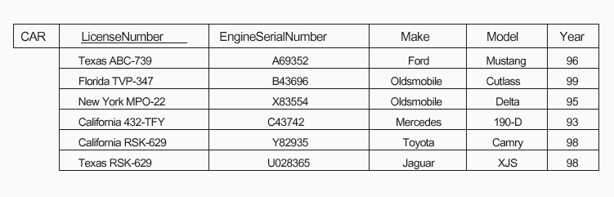
The CAR relation with two candidate keys:
LicenseNumber and EngineSerialNumber.

Slide 26
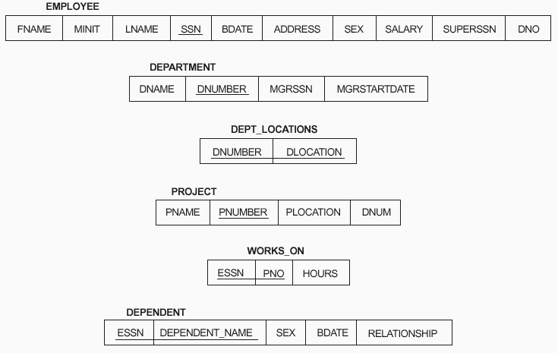
Schema diagram for the COMPANY relational database schema The primary keys are underlined.

Slide 27
Integrity Constraints (IC)
IC ensures accuracy and consistency of data
  Entity integrity constraints
  Referential integrity constraints
Relational database schema =
relation schemas + integrity constraints

Slide 28
Entity Integrity Constraint
Constraints on a single relation.
Entity Integrity Constraint: No primary key value can be NULL.
Let PK be the primary key attributes of a relation schema R:
t[PK] ≠ NULL for any tuple t in any state r(R)
  Note: NULL is not allowed in any attribute of PK.

Slide 29
Why Entity Integrity Constraints?
If two or more tuples had NULL for their primary keys, we might not be able to distinguish them if we tried to reference them.
Note: Other attributes of R may be similarly constrained to disallow null values, which is called NOT NULL constraint.

Slide 30
?
So far, all constraints are specified within
a single relation.
What if tuples in two relations are related?
typo
SID | Name | Address
101 | Alice | Rolla
SID | Course | Grade
111 | CS238 | A
101 | CS304 | A

Slide 31
Referential Integrity
A constraint involving two relations: referencing relation & referenced relation.
The constraint states that any tuple in a referencing relation must refer to an existing tuple in the referenced relation.
When we need such a constraint and
How to refer?
  Foreign key (FK)

Slide 32
Referential Integrity
Foreign Key (FK): Tuples in the referencing relation R1 have attributes FK that reference the primary key attributes PK of the referenced relation R2. A tuple t1 in R1 is said to reference a tuple t2 in R2 if t1[FK] = t2[PK], or t1[FK]=NULL.
For example: SID is a foreign key in R2.
R1
R2
SID | Name | Address
101 | Alice | Rolla
SID | Course | Grade
111 | CS238 | A
101 | CS304 | A

Slide 33
Referential Integrity
A referential integrity constraint can be displayed in a relational database schema as a directed arc from R1.FK to R2.
R1
R2
SID | Name | Address
SID | Course | Grade

Slide 34
Valid and Invalid State
Valid state: A database state satisfies all the integrity constraints.
Invalid state: A database state that does not obey all the integrity constraints.
R1
Invalid state
R2
SID | Name | Address
101 | Alice | Rolla
SID | Course | Grade
111 | CS238 | A
101 | CS304 | A

Slide 35
Displaying a relational database schema and its constraints
Each relation schema can be displayed as a row of attribute names
The name of the relation is written above the attribute names
The primary key attribute (or attributes) will be underlined
A foreign key (referential integrity) constraints is displayed as a directed arc (arrow) from the foreign key attributes to the referenced table
  For clarity, can also point to the primary key of the referenced relation.

Slide 36
How to identify a foreign key?
Start from a candidate key.
Check if it is referenced by other relations or even other attributes in the same relation.

Slide 37

Referencing and referenced relations can be the same

Slide 38
Exercise
Consider the following relations for a database that keeps track of student enrollment in courses and the books adopted for each course:
STUDENT(SSN, Name, Major, Bdate)
COURSE(Course#, Cname, Dept)
ENROLL(SSN, Course#, Quarter, Grade)
BOOK_ADOPTION(Course#, Quarter, Book_ISBN)
TEXT(Book_ISBN, Book_Title, Publisher, Author)
Draw a relational schema diagram specifying the foreign keys for this schema.

Slide 39
Brief Review
Relational model concepts
Relational model constraints
  Domain constraints / NOT NULL constraints (on attributes)
  Key constraints (on a single relation)
  Entity integrity constraint (on a single relation)
  Referential integrity constraint (on two relations)

Slide 40
Operations of the Relational Model
Operations can be categorized into
  Retrieval
    Query a database
  Updates
    Change the database
Basic update operations for changing the database:
  INSERT a new tuple in a relation
  DELETE an existing tuple from a relation
  MODIFY an attribute of an existing tuple

Slide 41
Update Operations on Relations
Integrity constraints should not be violated by the update operations.
Updates may propagate to cause other updates automatically. This may be necessary to maintain integrity constraints.

Slide 42
Example Relations
R
tid | sid | course
20 | 202 | os
10 | 450 | calculus
20 | 202 | db
20 | 240 | db
S
sid | sname | year
240 | white | 3
202 | jones | 3
450 | adams | 1
T
tid | tname | dept
10 | cohen | math
20 | levy | cs
1. Values of all attributes are string
except that “year” is integer.
2. “dept” cannot be NULL

Slide 43
Possible Violations for Insert Operation
INSERT may violate any of the constraints:
  Domain constraint / NOT NULL constraint:
    if one of the attribute values provided for the new tuple is not of the specified attribute domain or it is NULL when not allowed
  Key constraint:
    if the value of a key attribute in the new tuple already exists in another tuple in the relation
  Entity integrity:
    if the primary key value is NULL in the new tuple
  Referential integrity:
    if a foreign key value in the new tuple references a primary key value that does not exist in the referenced relation

Slide 44
Possible Violations for Delete Operation
DELETE may violate only referential integrity:
  If the primary key value of the tuple being deleted is referenced from other tuples in the database
  Can be remedied by several actions
    Reject the deletion
    Propagate the change to the referencing tuples
    Set the foreign keys of the referencing tuples to NULL when the referencing attributes are not part of the primary key
  One of the above options must be specified during database design for each foreign key constraint

Slide 45
Possible Violations for Modify Operation
MODIFY may violate any of the constraints when
  Updating the primary key (PK)
    Similar to a DELETE followed by an INSERT
    Need to specify similar options to DELETE
  Updating a foreign key (FK)
    May violate referential integrity
  Updating an ordinary attribute (neither PK nor FK):
    Can only violate domain constraints or NOT NULL constraint

Slide 46
How to Deal With Violations?
In case of integrity violation caused by any operation, several actions can be taken:
  Reject the operation that causes the violation
  Correct the violation by triggering additional updates
  Perform the operation but inform the user of the violation
  Execute a user-specified error-correction routine

Slide 47
Triggers
A trigger is a statement that is executed automatically by the system as a side effect of a modification to the database.
To design a trigger mechanism, we must:
  Specify the conditions under which the trigger is to be executed.
  Specify the actions to be taken when the trigger executes.
Triggers introduced to SQL standard in SQL:1999, but supported even earlier using non-standard syntax by most databases.

Slide 48
Trigger Example
Suppose that instead of allowing negative account balances, the bank deals with overdrafts by
  setting the account balance to zero
  creating a loan in the amount of the overdraft
  giving this loan a loan number identical to the account number of the overdrawn account
The condition for executing the trigger is an update to the account relation that results in a negative balance value.

Slide 49
Trigger Example
create trigger overdraft-trigger after update on account
referencing new row as nrow for each row
when nrow.balance < 0
begin atomic
insert into borrower
(select customer-name, account-number
from depositor
where nrow.account-number =
depositor.account-number);
insert into loan values
(n.row.account-number, nrow.branch-name,
– nrow.balance);
update account set balance = 0
where account.account-number = nrow.account-number
end

Slide 50
Triggering Events and Actions in SQL
Triggering event can be insert, delete or update
Triggers on update can be restricted to specific attributes
  E.g. create trigger overdraft-trigger after update of balance on account
Values of attributes before and after an update can be referenced
  referencing old row as : for deletes and updates
  referencing new row as : for inserts and updates
Triggers can be activated before an event, which can serve as extra constraints. E.g. convert blanks to null.
create trigger setnull-trigger before update on r
referencing new row as nrow
for each row
when nrow.phone-number = ‘ ‘
set nrow.phone-number = null

Slide 51
What’s Next
Relational Algebra

